Slide 1
TEXT PROMPTS FOR REACT TEST GENERATION

Slide 2
LLMs experimented on :
Code Llama
StarChat
System Prompt used : You are a helpful, respectful and honest assistant with a deep knowledge of code and software design. Always answer as helpfully as possible, while being safe. Your answers should not include any harmful, unethical, racist, sexist, toxic, dangerous, or illegal content. Please ensure that your responses are socially unbiased and positive in nature.
If a question does not make any sense, or is not factually coherent, explain why instead of answering something not correct. If you don't know the answer to a question, please don't share false information.
LLMS not used : StarCoder and SantaCoder

Slide 3
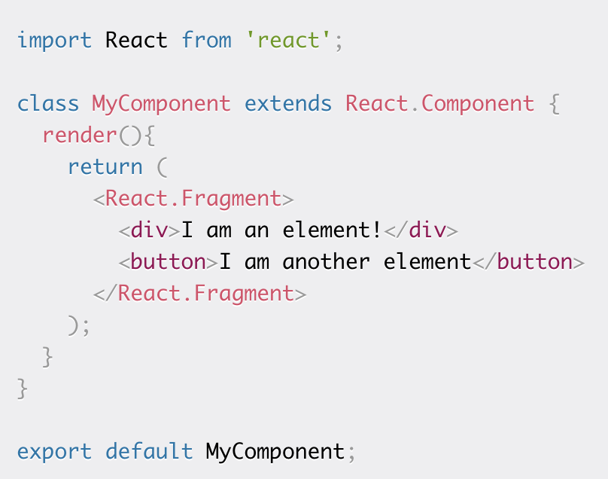
STARTER CODE – BASIC COMPONENT
generate tests for this react code :

Slide 4
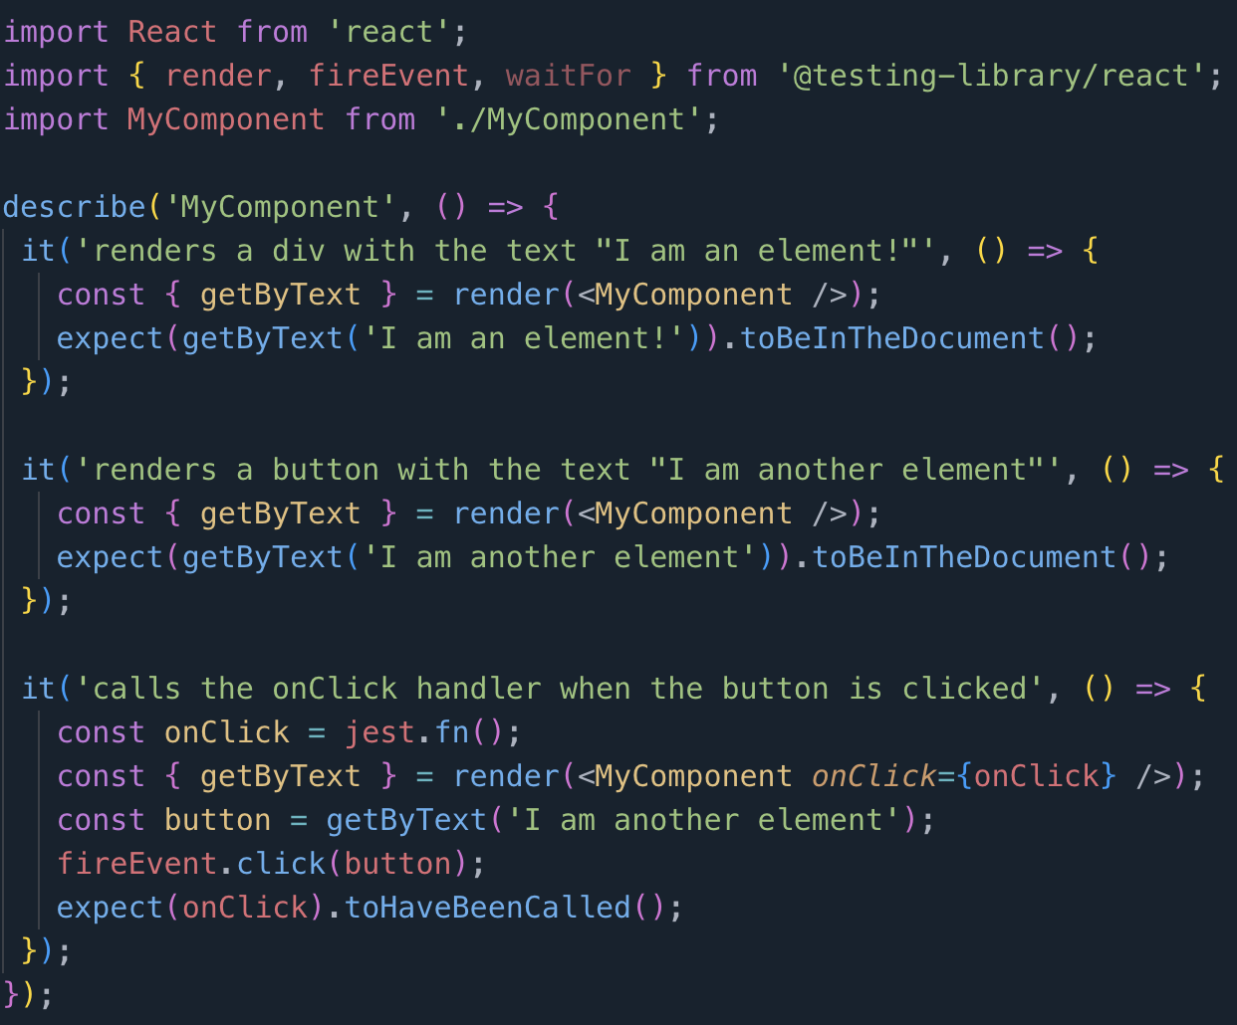
CODE LLAMA
JEST :

Slide 5
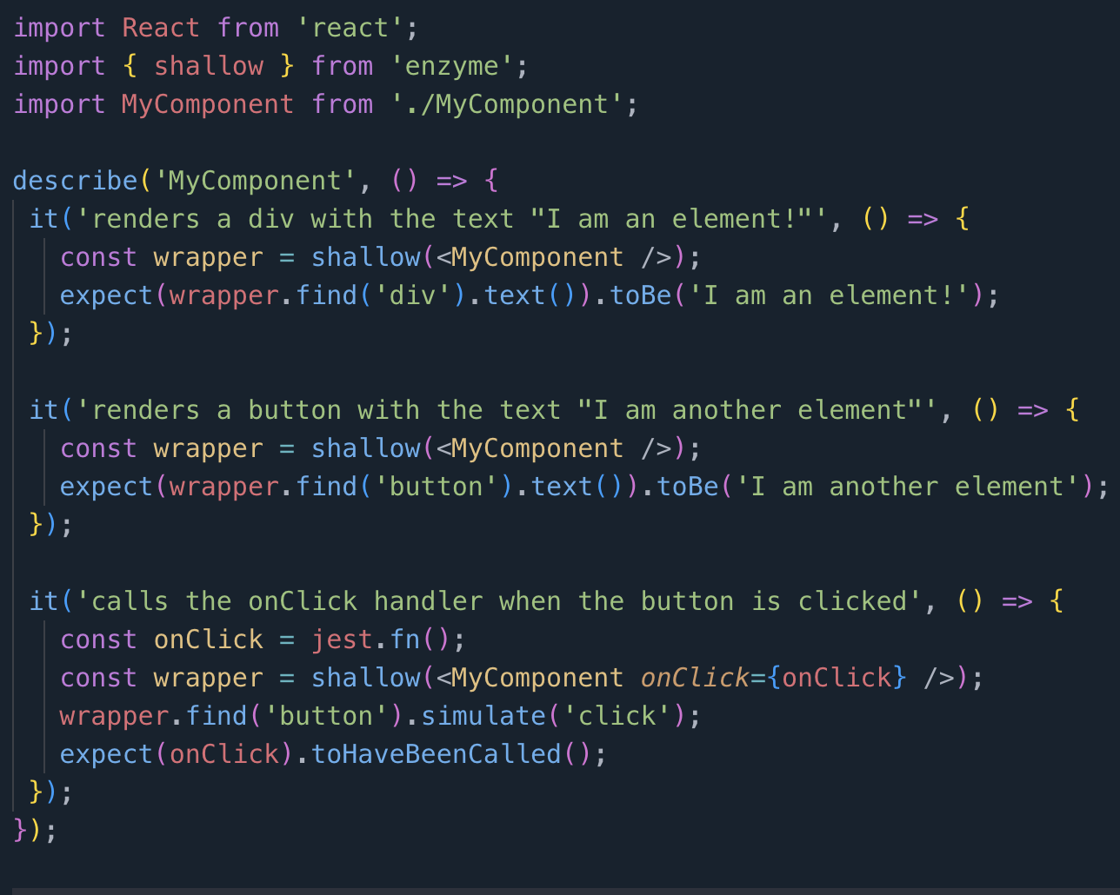
CODE LLAMA
ENZYME :

Slide 6
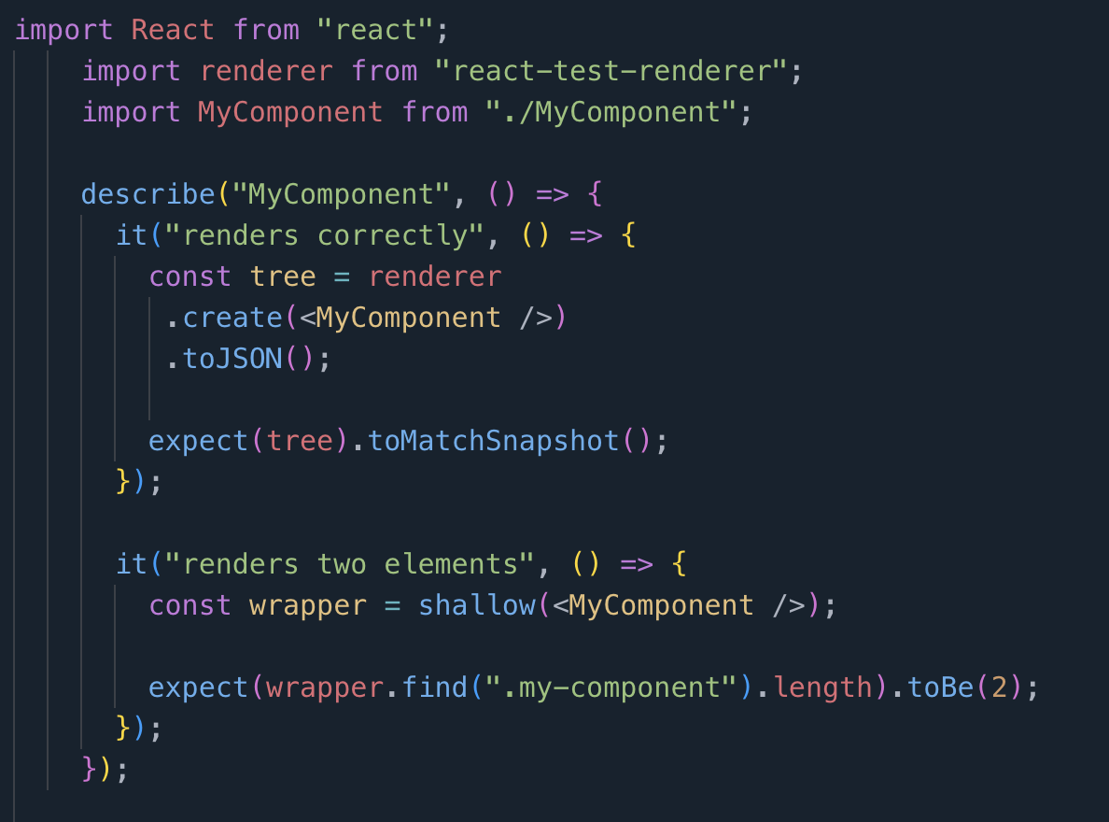
STAR CHAT
REACT TEST RENDERER :

Slide 7
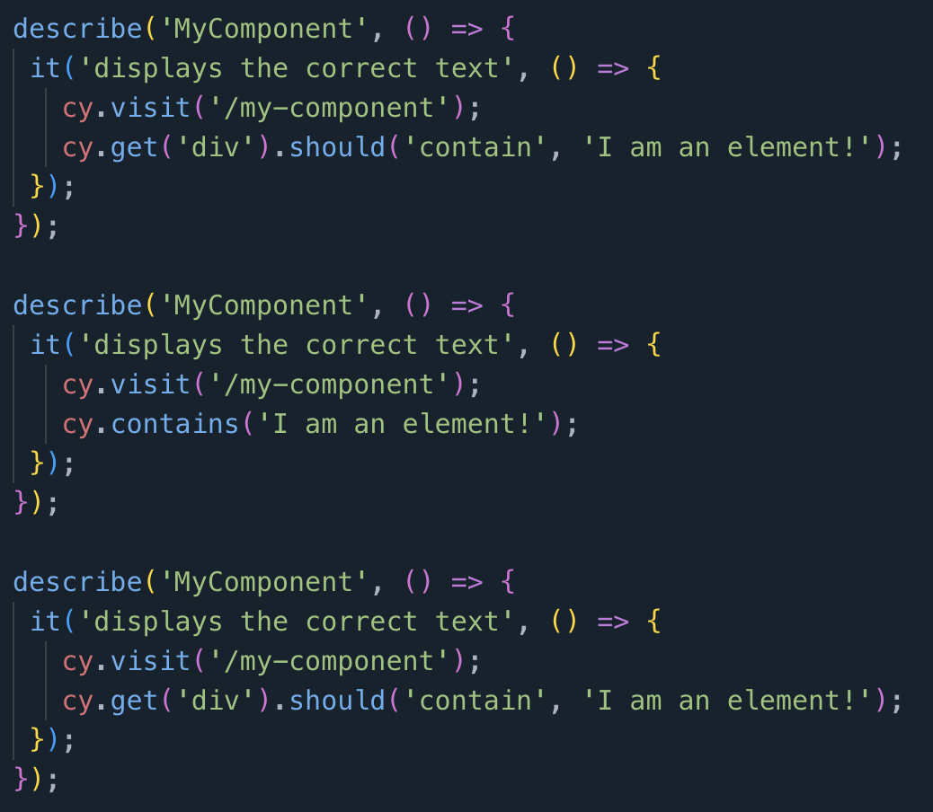
CODE LLAMA
write the test using cypress:

Slide 8
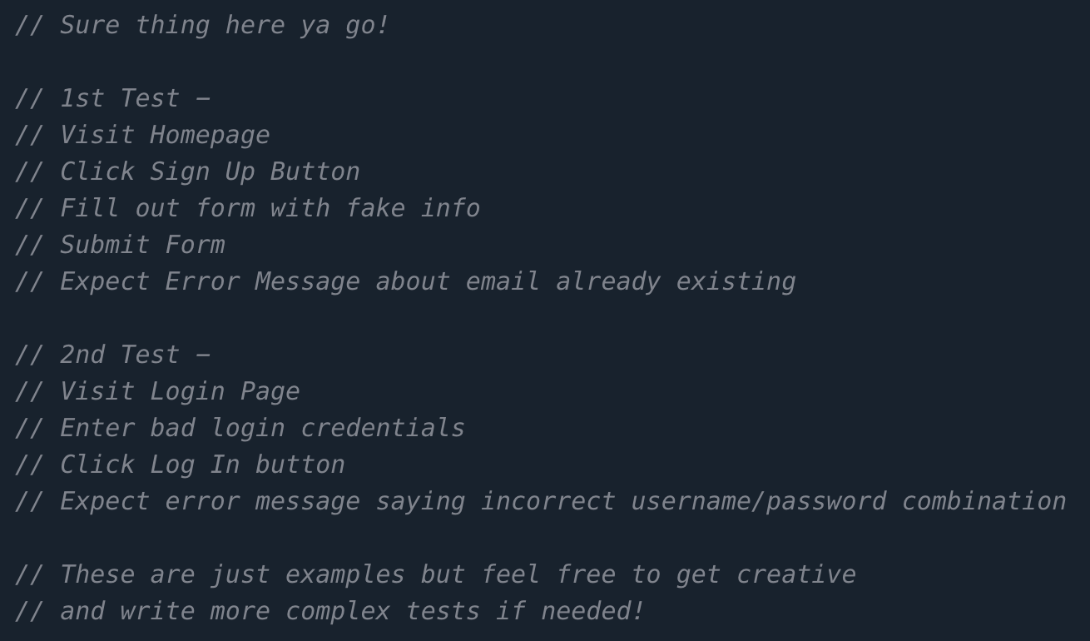
STAR CHAT
write the test using cypress:

Slide 9
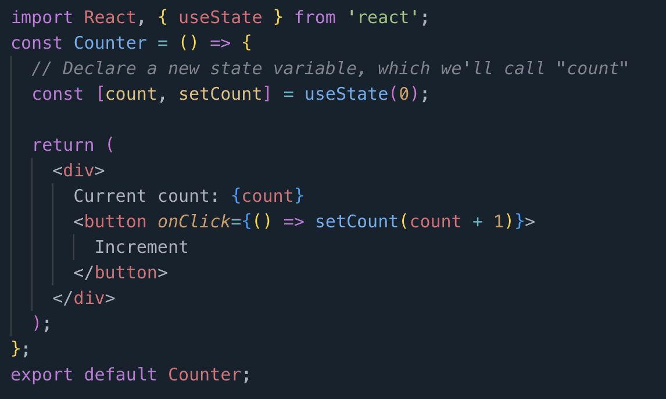
FUNCTIONAL COMPONENT WITH STATE
write cypress tests for the following react code :

Slide 10
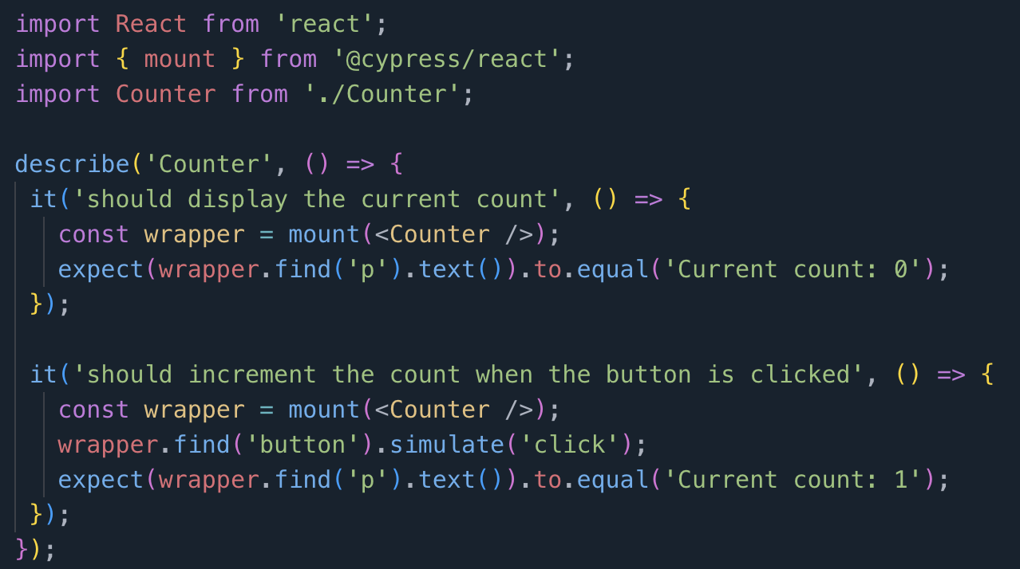
CODE LLAMA
write cypress tests for the following react code :

Slide 11
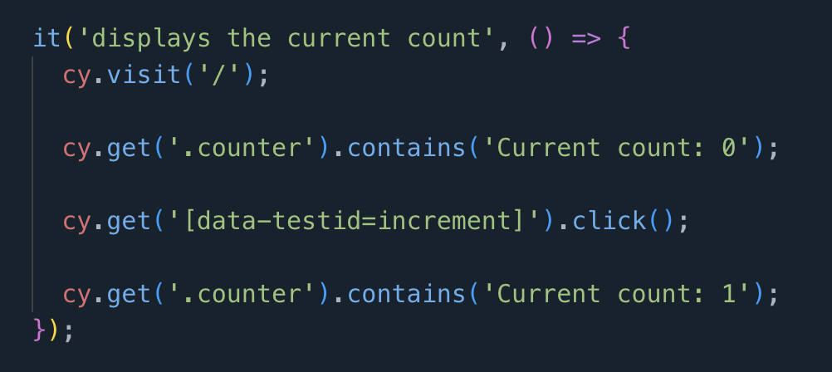
STAR CHAT
write cypress tests for the following react code :

Slide 12
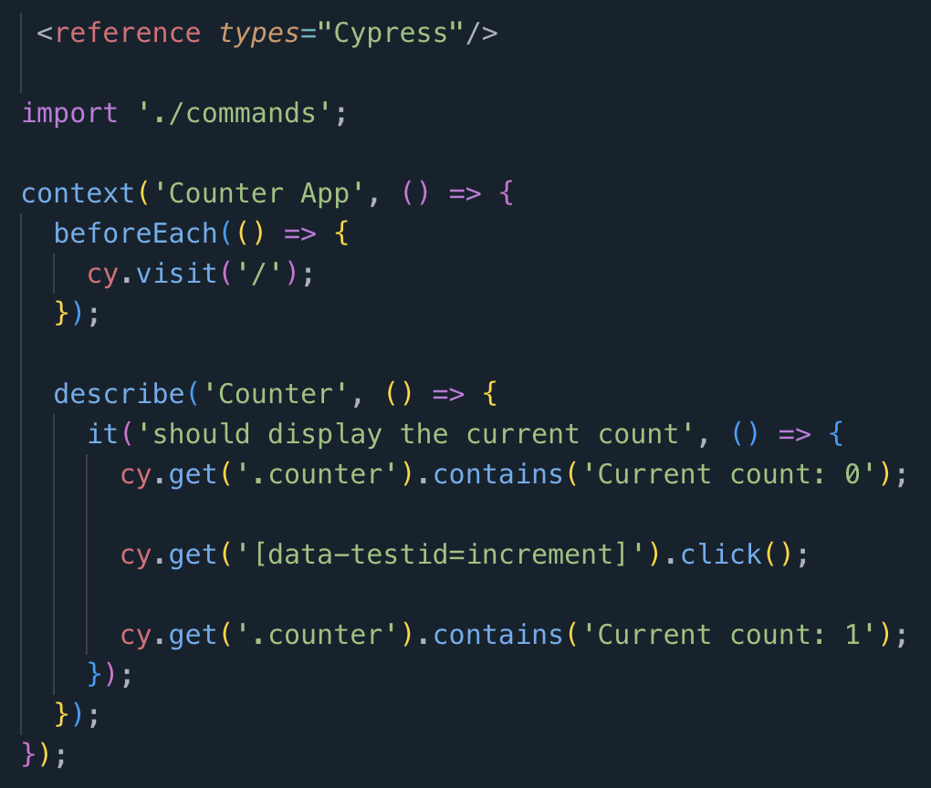
STAR CHAT
Improved input prompt : do not assume you know the path where the page is. Write a standalone test for the previous code

Slide 13
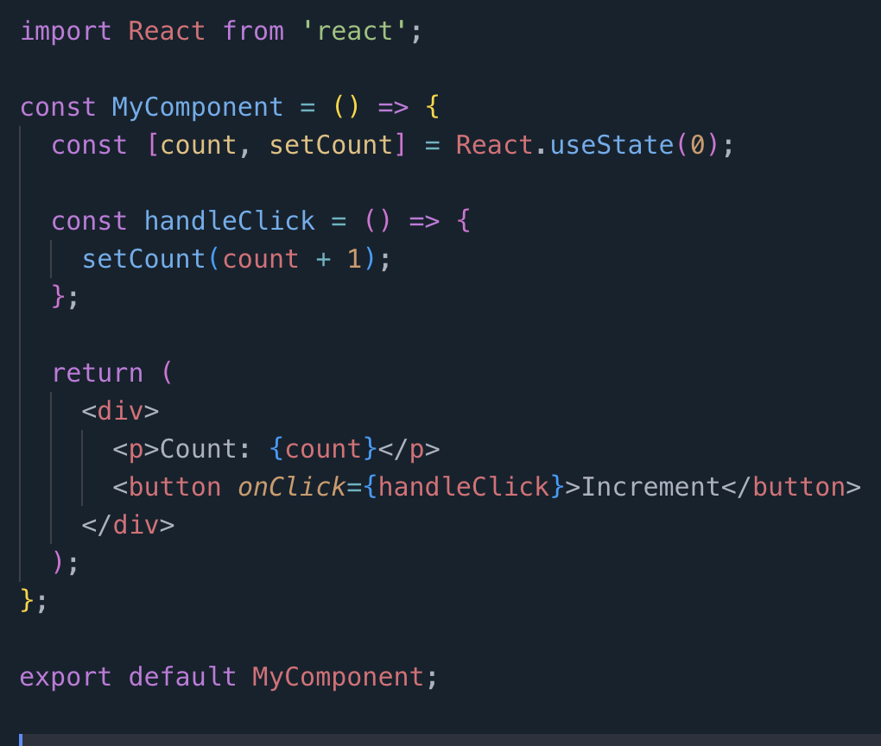
FUNCTIONAL COMPONENT WITH ANOTHER FUNCTION
write a test using cypress for following react code :

Slide 14
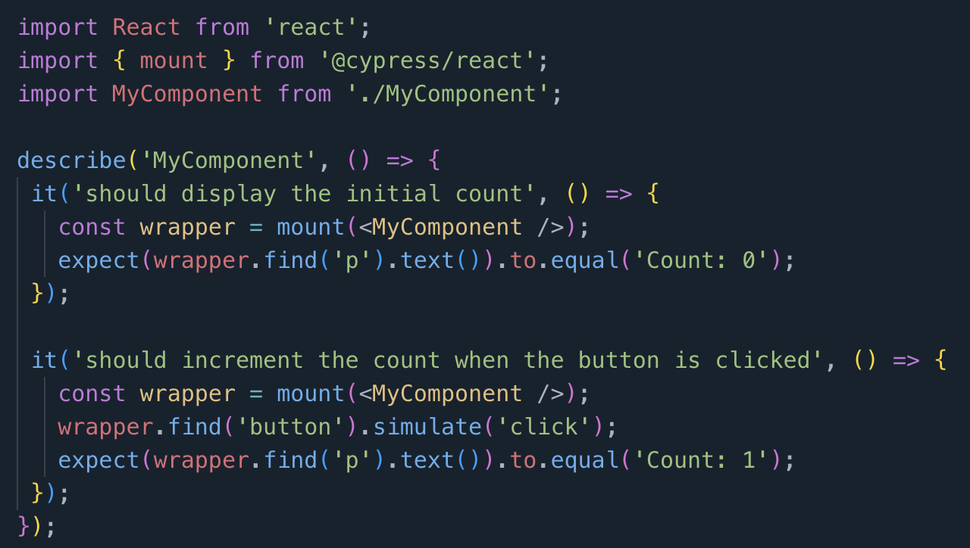
CODE LLAMA
write a test using cypress for following react code :

Slide 15
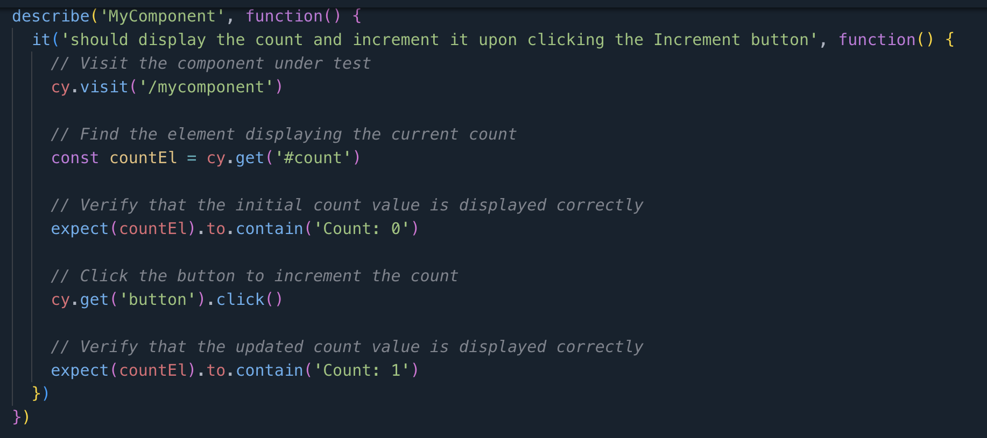
STAR CHAT
write a test using cypress for following react code :

Slide 16
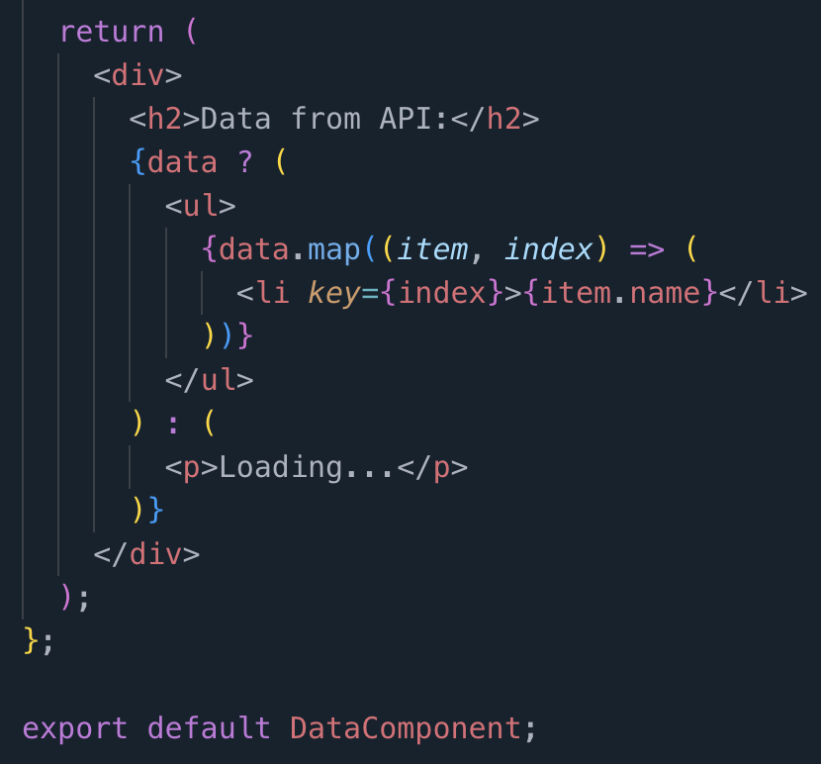
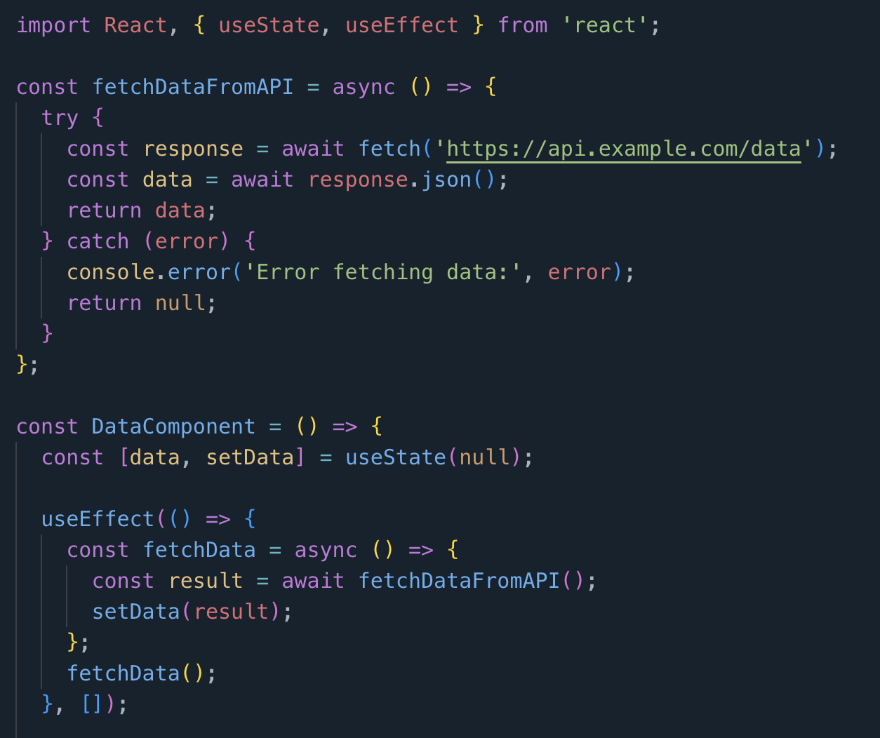
FUNCTIONAL COMPONENT WITH ANOTHER FUNCTION API CALL
write a test using cypress for following react code :

Slide 17
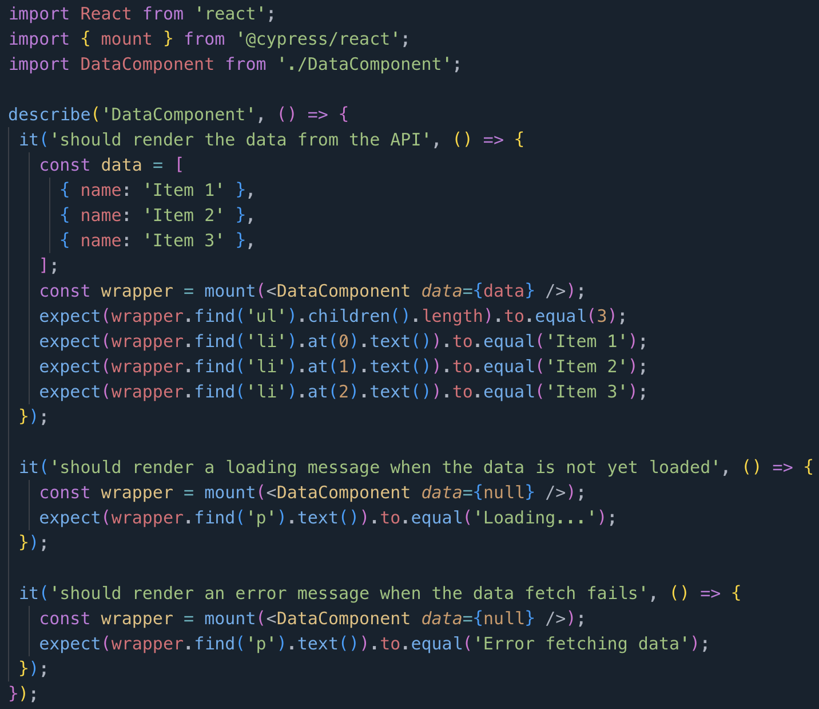
CODE LLAMA
write a test using cypress for following react code :

Slide 18
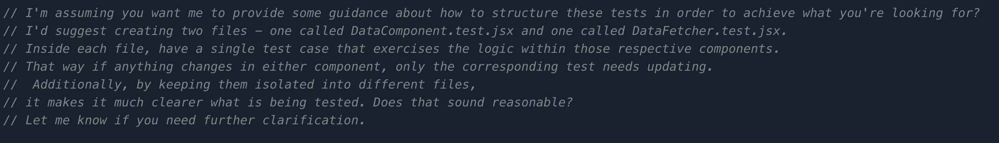
STAR CHAT
write tests in such a way that they run without modifying the existing code

Slide 19
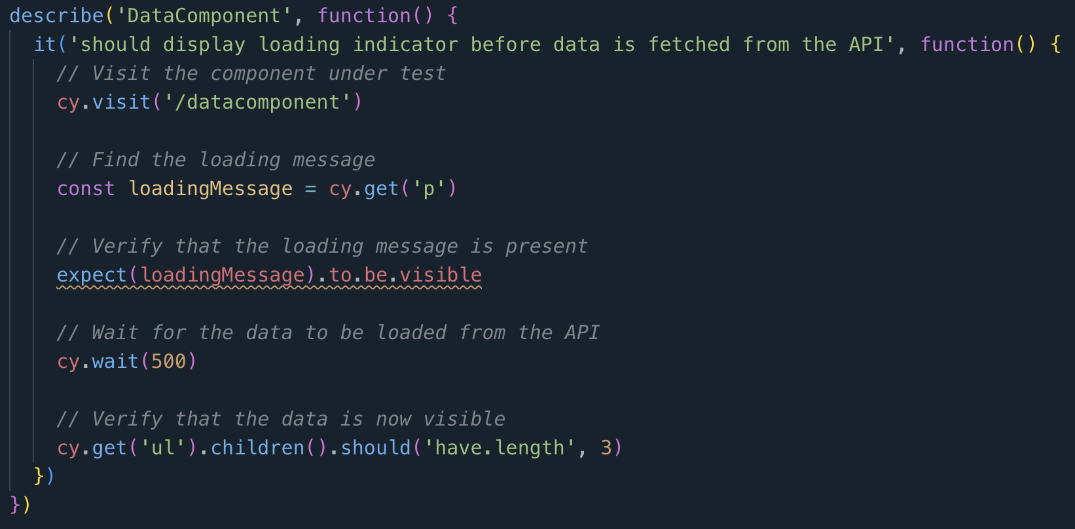
STAR CHAT Improvised prompt
write a test using cypress for following react code :

Slide 20
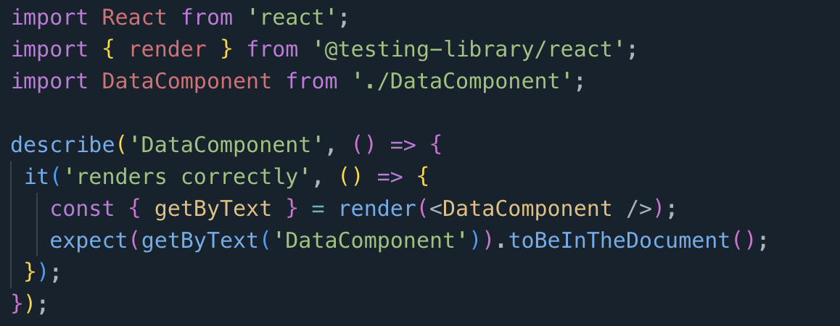
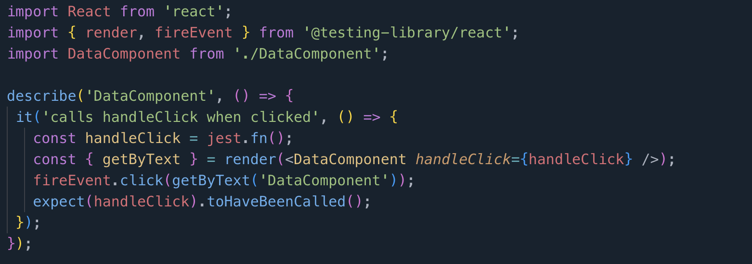
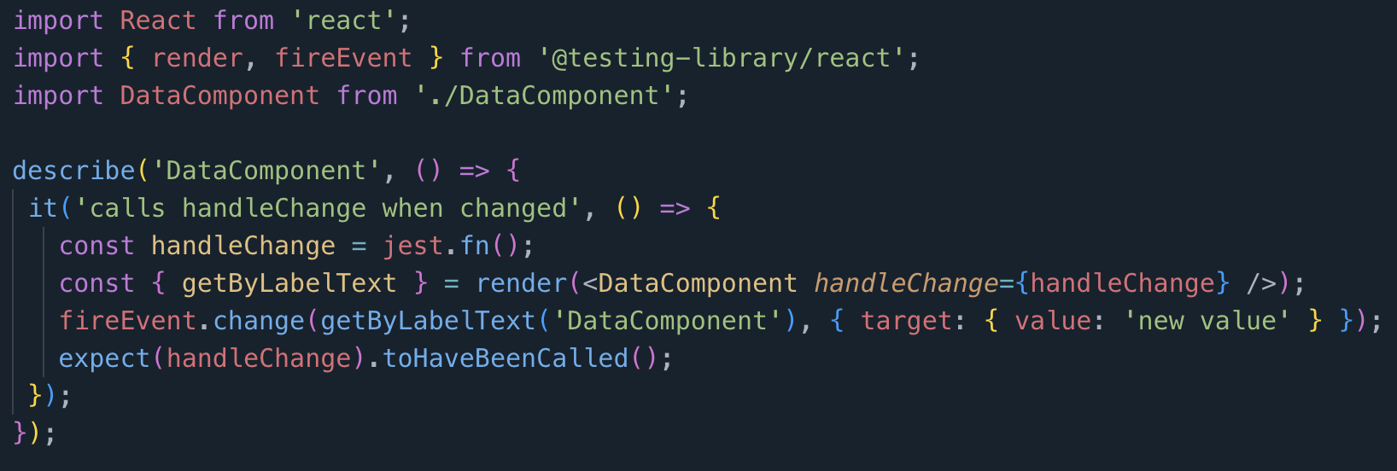
CODE LLAMA Improvised prompt
write tests in such a way that they run without modifying the existing code
Notes:
Gave 3 tests but not in cypress

Slide 21
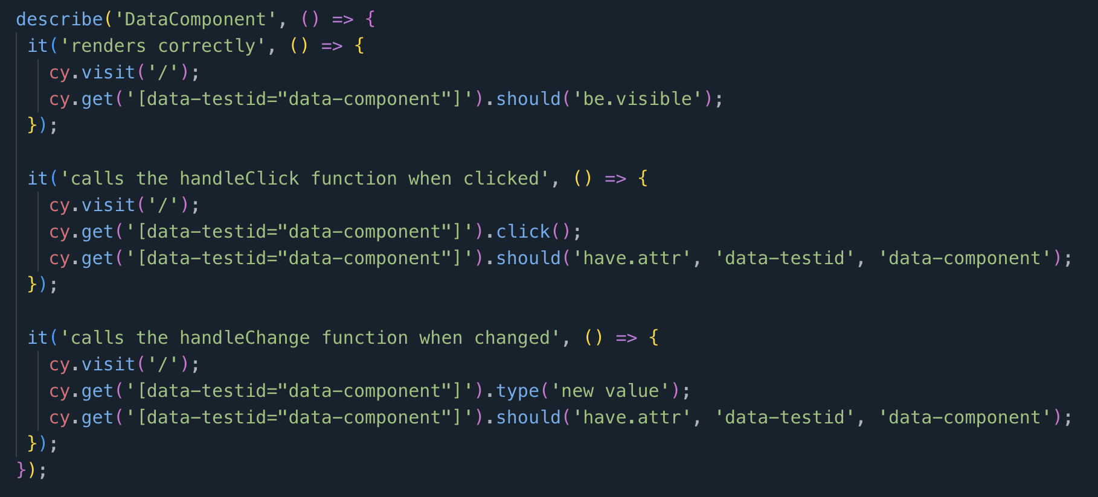
CODE LLAMA Improvised prompt
dont forget all tests should be written in cypress
Notes:
Gave 3 tests but not in cypress

Slide 22
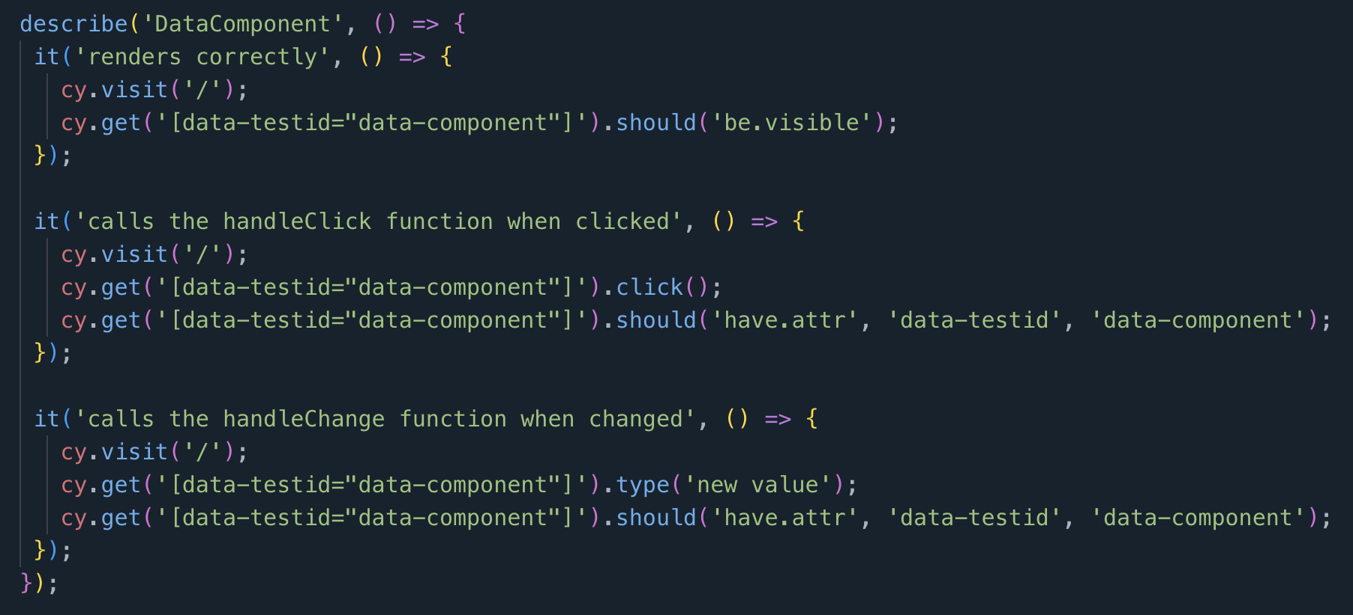
CODE LLAMA Improvised prompt
make sure along with tests being in cypress they should not assume to modify the input code given
Notes:
Gave 3 tests but not in cypress

